Slide 1
Image Steganography
RVS College of Engineering and Technology
Department of Computer Science
S.Karthik
N.Lavanya

Slide 2
STEGANOGRAPHY
Greek Words:
STEGANOS – “Covered”
GRAPHIA – “Writing”
Definition:
It is an art and science of hiding information by embedding it in some other data.
Goals:
To hide a secret message within an object.
Intruder cannot detect a message
Primarily 1:1 communication

Slide 3
Types of Steganography
Steganography In Text/Documents
Steganography In Images
Steganography In Audio
Steganography In Protocols(TCP/IP Packets)

Slide 4
Image Steganography
Image Steganography is the technique of hiding the data within the image in such a way that prevents the unintended user from the detection of the hidden messages or data.
Images are used as the message carriers.Images are the most popular cover objects used for steganography
It is the most widely used medium being used today
Takes advantage of our limited visual perception of colors

Slide 5
Cover Image
Image
Encryption
Process
Decryption
Process
Stegano-Object
Message
Message
Sender Side
Receiver Side

Slide 6
Classification of Steganographic Categories
Steganography is classified into 3 categories,
Pure steganography where there is no stego key. It is based on the assumption that no other party is aware of the communication.
Secret key steganography where the stego key is exchanged prior to communication. This is most suspectible to interception.
Public key steganography where a public key and a private key is used for secure communication.

Slide 7
IMAGE-ENCODING TECHNIQUES
The most common approaches to information hiding in images :
Least Significant Bit Insertion
Static Parsing Steganography(SPS)
Masking and Filtering

Slide 8
Least Significant Bit Substitution
A sample raster data for 3 pixels (9 bytes) may be:
00100111 11101000 11001000
00100110 11001000 11101000
11001001 00100111 11101011
After inserting the binary value:
00100111 11101001 11001000
00100111 11001000 11101001
11001000 00100111 11101011
Inserting the binary value for A (10000001) changes 4 bits

Slide 9
Least Significant Bit Substitution Methodology
Cover Image
Message
Image
Convert each pixel value into binary
Calculate size of message (rows,columns)
Convert each pixel into
binary
Reserve first 20 pixels for hiding message size information
Sequentially Replace LSB’s of cover
image pixels with message bit

Slide 10
IMAGE ATTRIBUTES
Digital images are made up of pixels
The arrangement of pixels make up the image’s “raster data”
8-bit and 24-bit images are common
The larger the image size, the more information you can hide. However, larger images may require compression to avoid detection.

Slide 11
Applications Of Steganography
Confidential communication and secret data storing
Access control system for digital content distribution
Secure Private Files and Documents.
Transport Highly Private Documents between International Governments.
Transmit message/data without revealing the existence of available message.

Slide 12
History of steganography
The first recorded uses of steganography can be traced back to 440 BC when Herodotus mentions an example of steganography in the histories of Herodotus.
Some of the technics used are:
Shaving the head
Wood tablet covered with wax
Microdots
Invisible ink
Vexierbild
Acrostic
Paper mask

Slide 13
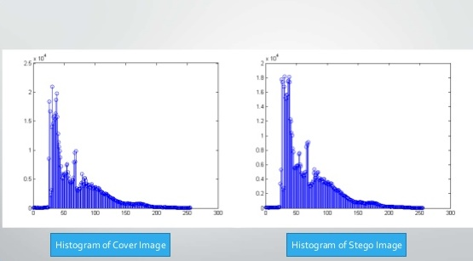
Histogramic Representation

Slide 14


